Slide 1
A Walk in Quantum Land
Vincent Cai, Daniel Jung, Jacob Paras, Rohan Phanse, and Marcus Schubert
MRJDV

Slide 2
01
Quantum Circuit Design

Slide 3
Lively Quantum Random Walk
Liveliness
Parameter that controls step size of a random walk
Control
Classically parameterized by input, generates a quantum superposition step state over one or more qubits
Quantum Random Walk
Increment and decrement step functions controlled by ancilla qubits after coin function operation.

Slide 4
Quantum Random Walk & Step Function
Step Function
Circuit that maps every basis state to the next basis state or previous basis state (increment or decrement).
Coin Function
Generates a classically parameterized qutrit control register (superposition over three possible coin states)
Shift Function
Relies on the bit state to modify the coin and “shift” operators applied that bit.

Slide 5
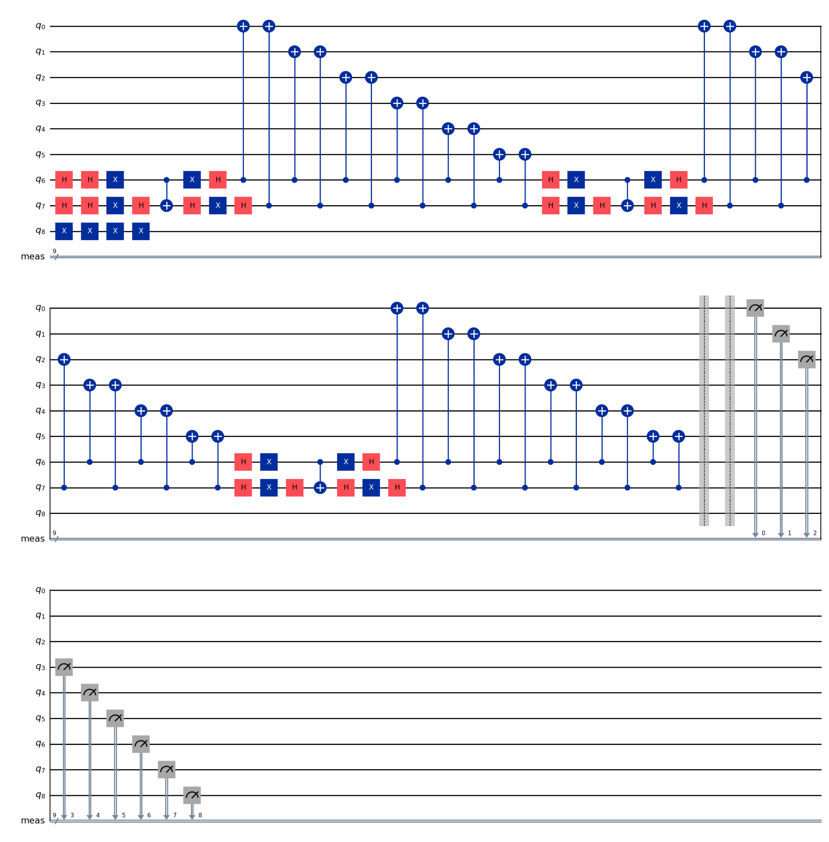
The Circuit
Generated for bitstring message “101” with N=32 (2^5).

Slide 6
02
Testing the Hash

Slide 7
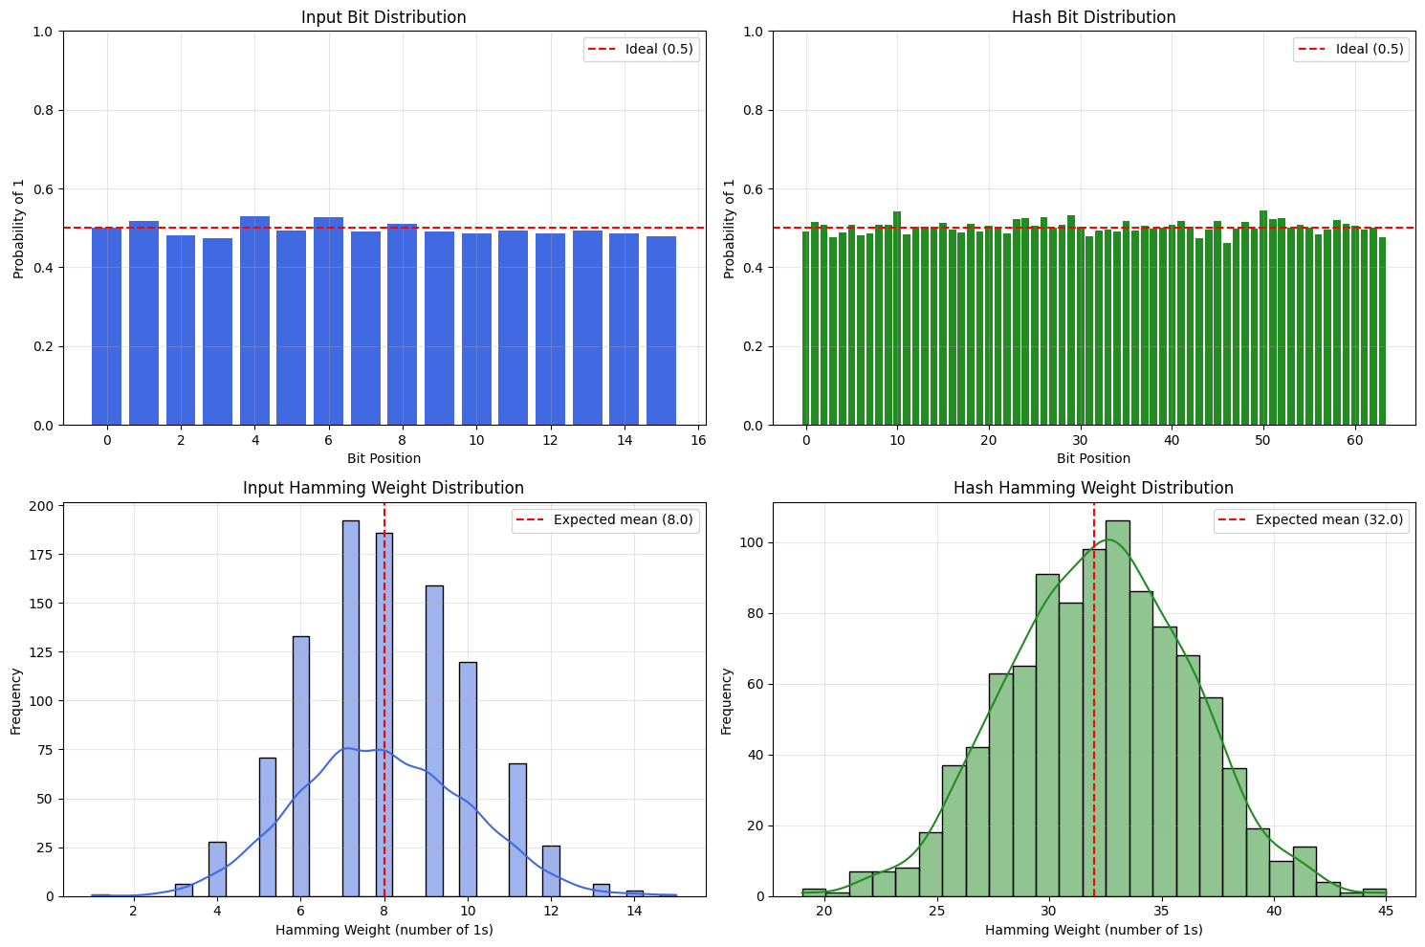
Preservation of Entropy
Comparison of the input and output distributions:

Slide 8
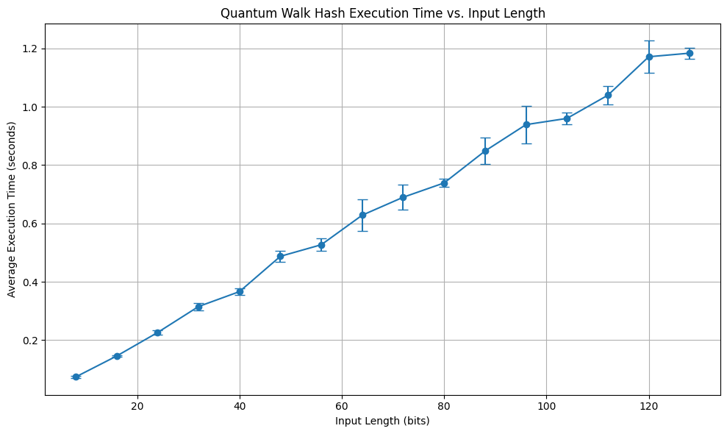
Computation Time

Slide 9
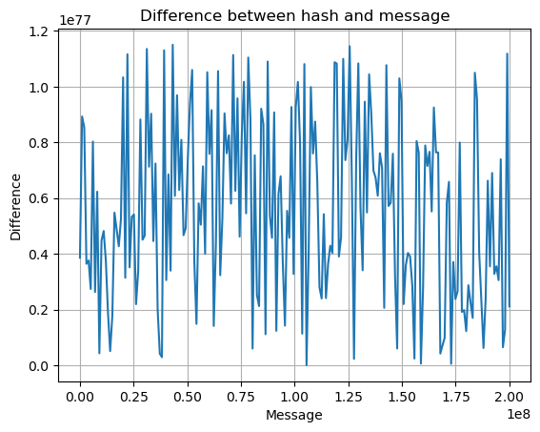
Preimage Resistance
Measuring difference between the hashed output and the input message (bits converted to integers):

Slide 10
No stochastic parameters in circuit
embedding and postprocessing are deterministic processes
For various inputs: 1500 iterations, same input → same output
Output Determinism
Computational Difficulty
O(N)
Time complexity scales linearly with the number of input bits
Collision Resistance
2 million iterations with 0 collisions (GPU accelerated)
Computational Feasibility
5 (position) + 2 (coin operator) + 1 (message) = 8 cubits
Other Evaluation Criteria

Slide 11
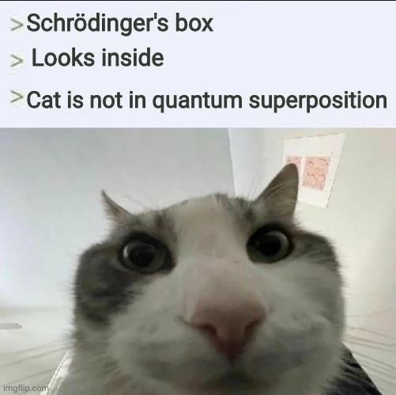
Questions?

Slide 12
THANK YOU
MRJDV

